Slide 1
Three-tier web app Project
Senthil Balasubramanian

Slide 2
Design DeCISIONS
Managed database (cloud sql)
Private-only ips for databases (private service access)
Private dns for database hostnames (cloud dns)
Secrets stored in secret manager (secret manager for db_ro_user/pwd)
Serverless container runtime (cloud run, artifact registry)
Global load balancer with tls (http(s) load balancing, managed certificate)
Waf firewall (cloud armor)

Slide 3
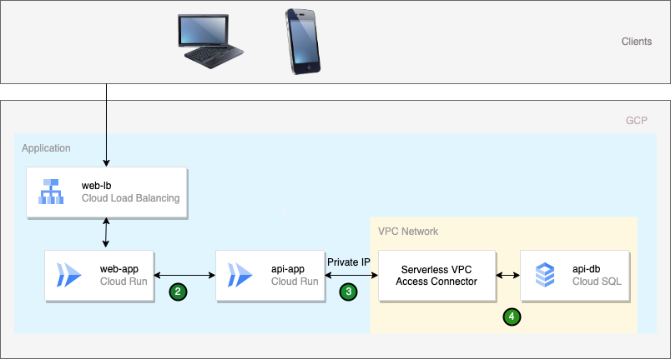
Planned GCP Architecure
External HTTPS LB configuration
Cloud CDN
WAF Firewall (Cloud Armor)
Managed Certificate

Slide 4
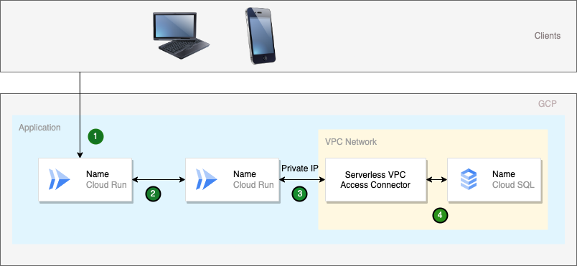
GCP Architecture

Slide 5
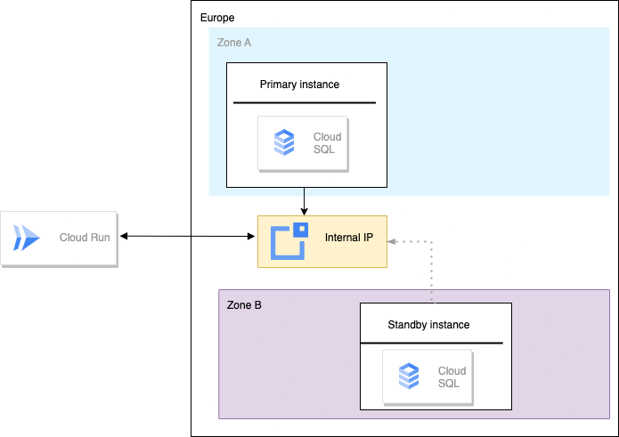
DB COnfiguration
DB FlaGS
PITR
Delete PROTECTION
AUTO STORAGE INCREASE
BACKUPS

Slide 6
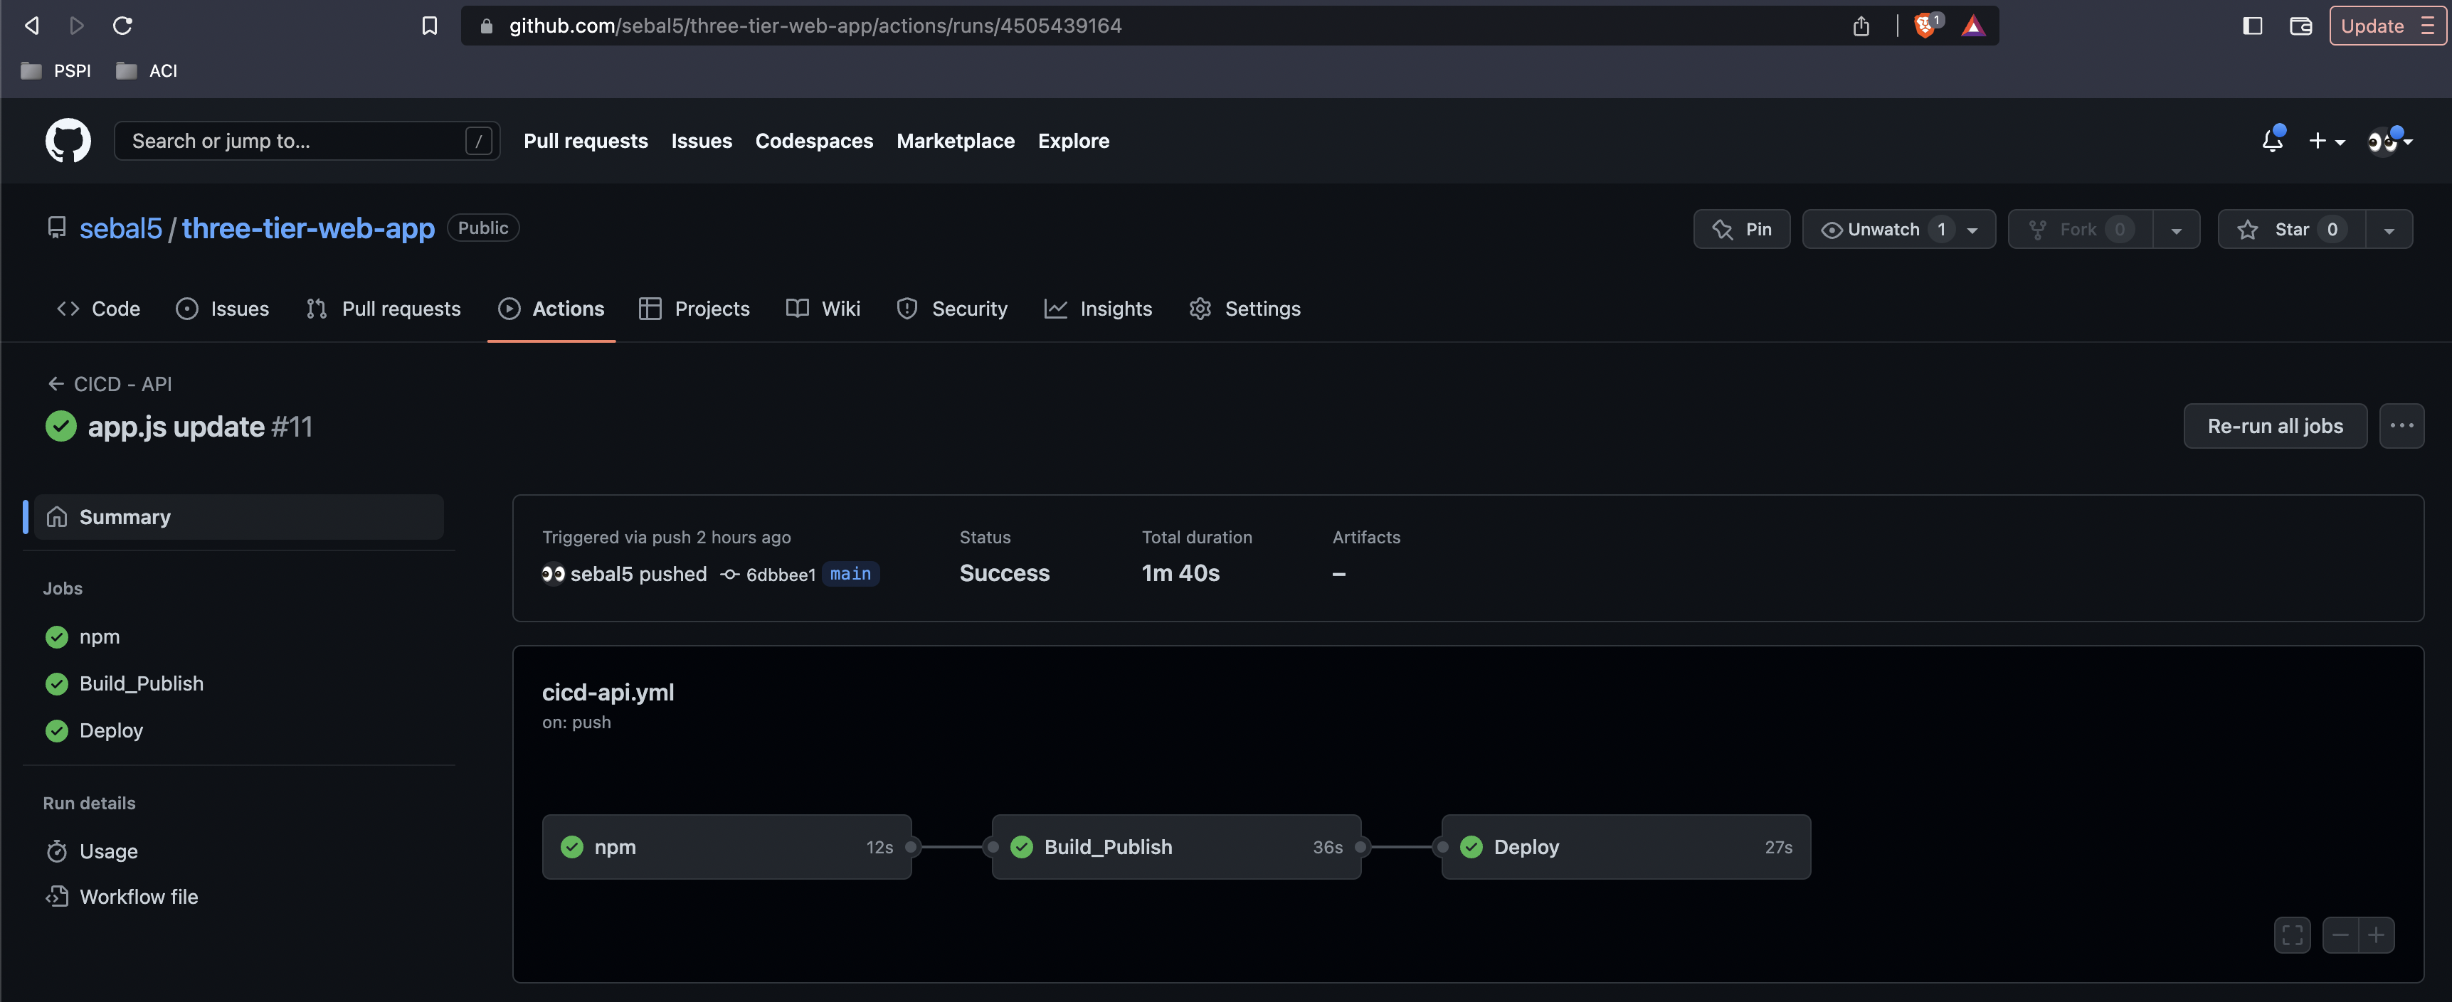
CICD PIPELINE – API/WEB

Slide 7
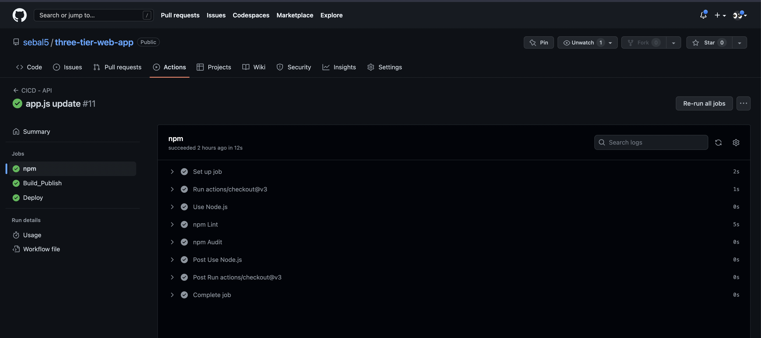
CICD PIPELINE – API/WEB (cont’d)

Slide 8
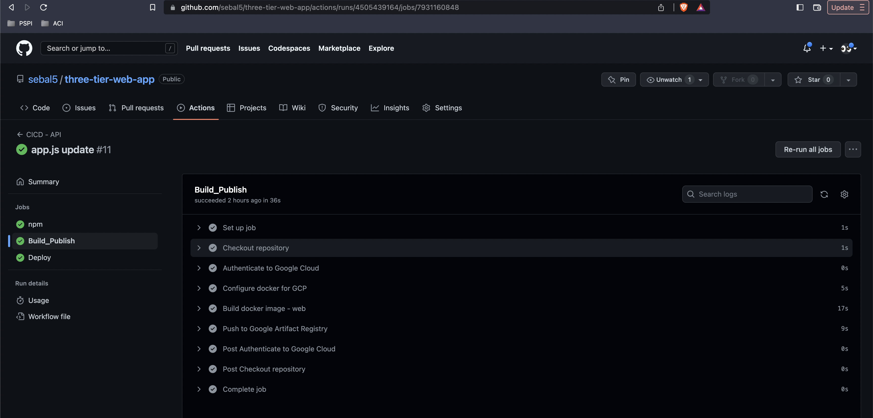
CICD PIPELINE – API/WEB (cont’d)

Slide 9
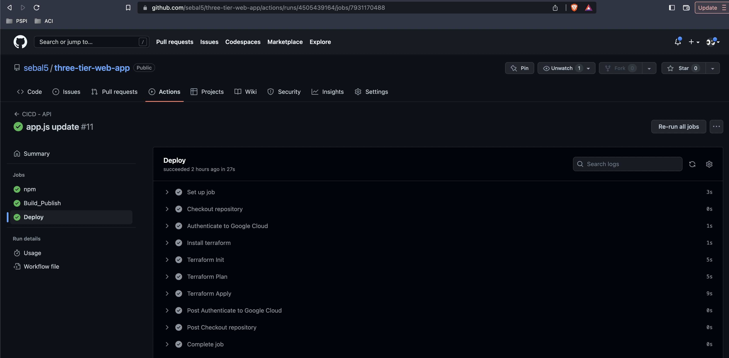
CICD PIPELINE – API/WEB (cont’d)

Slide 10
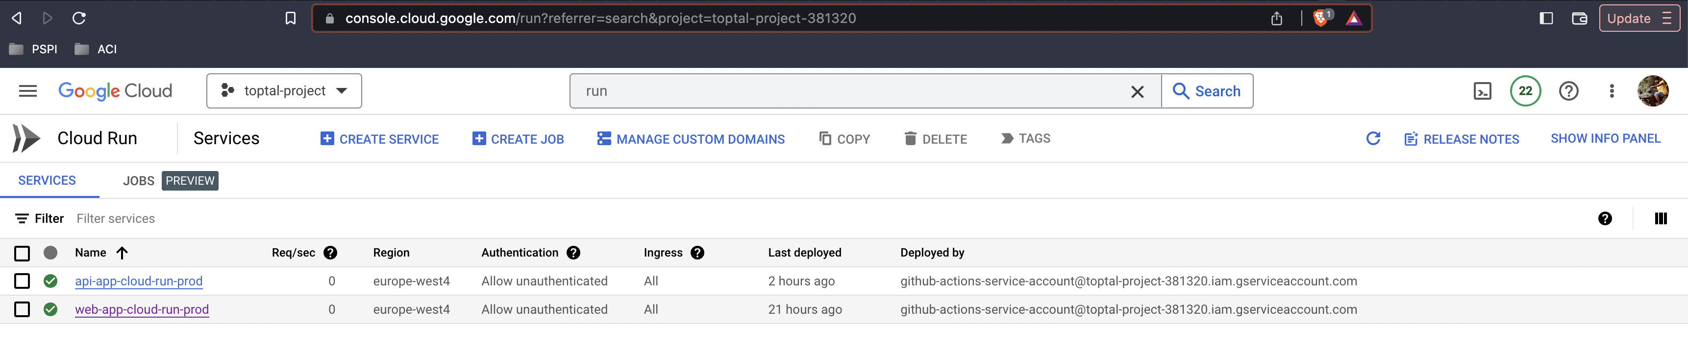
GCP Web & API Deployment

Slide 11
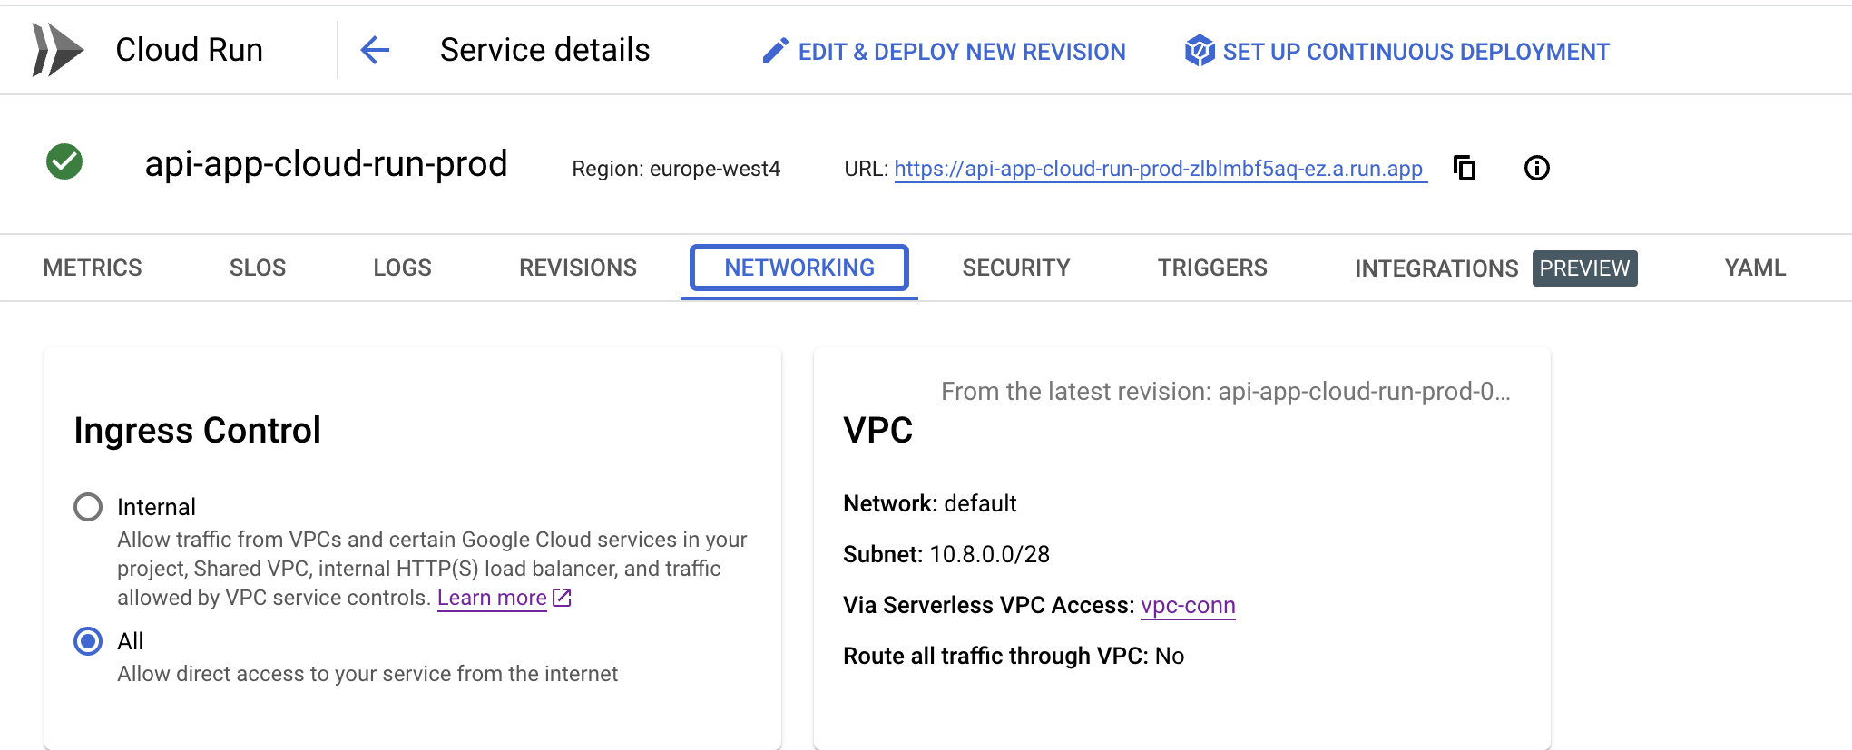
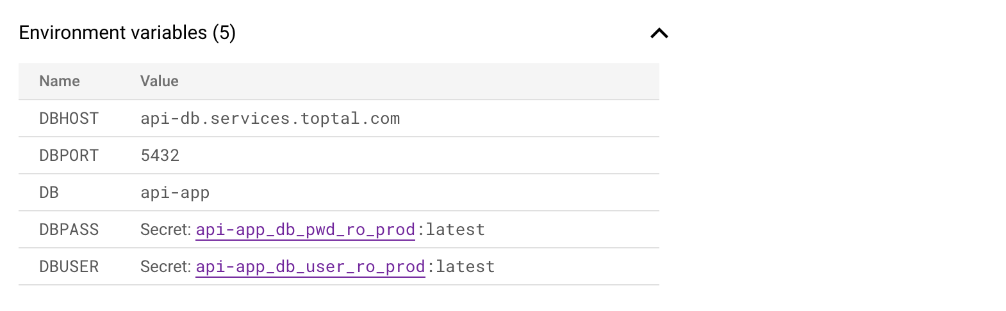
API service configuration (cont’d)

Slide 12
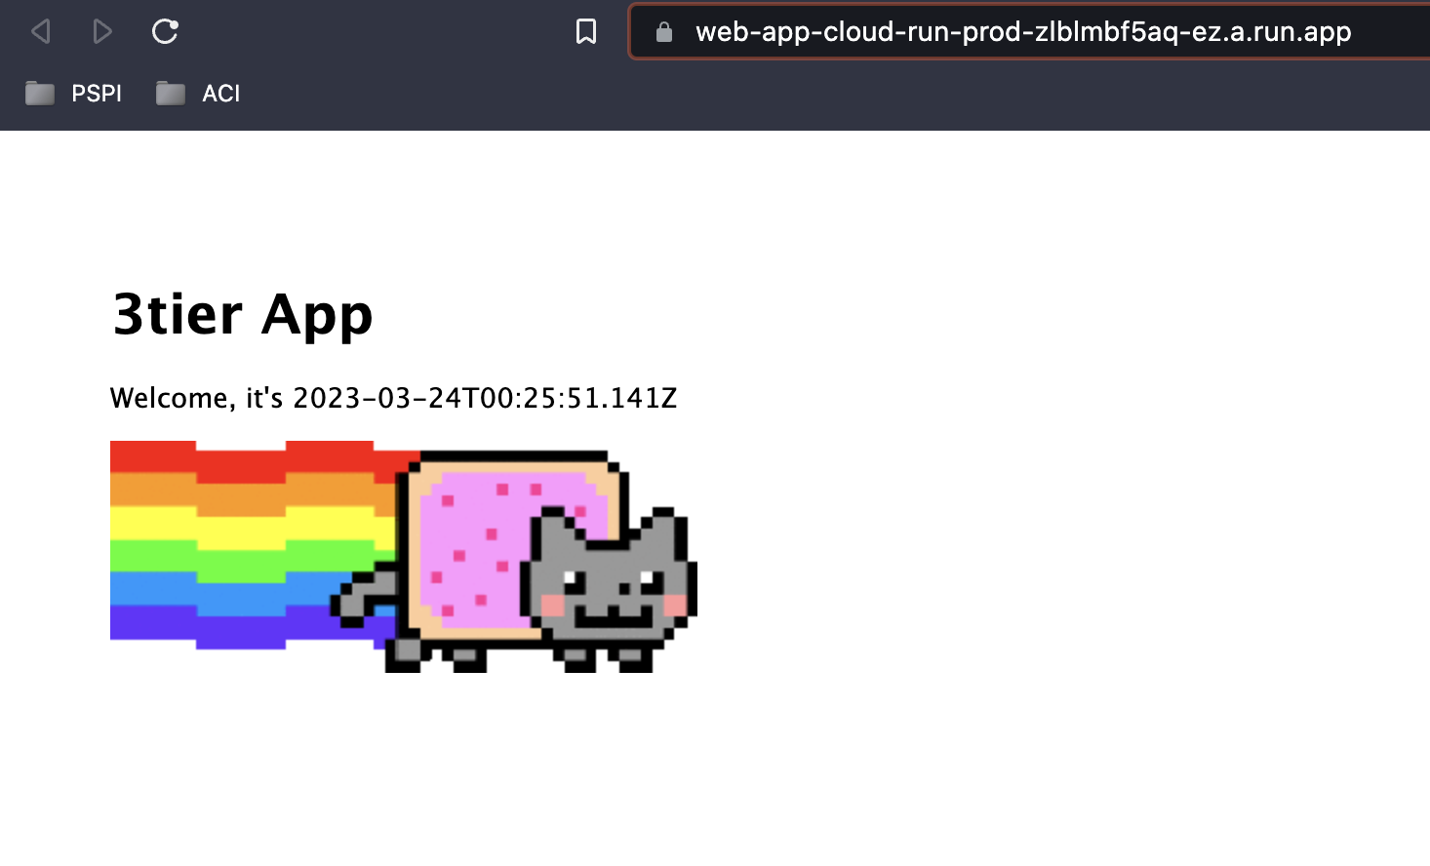
ReSULT

